Slide 1

Typed First-Class Traits
Xuan Bi and Bruno C. d. S. Oliveira
The University of Hong Kong
19 July 2018, ECOOP, Amsterdam

Slide 2
First-Class Classes
Many dynamically-typed languages (JavaScript, Ruby, Python, etc.) support first-class classes
First-class classes are very expressive: mixins
Take any class as argument
const classFunc = Base => { return class extends Base { methodA() { return "add methodA"; } } }
Return a new class
Dynamic inheritance

Slide 3
Typed First-Class Classes
Classes in most statically-typed languages(Java, Scala or C++) are a second-class construct
Little work on typing of first-class classes
Difficulties of typing dynamic inheritance, mixins
Some progress recently
Typed Racket’s gradually typed firs—class classes*
Lee et al.’s model of typed first-class classes**
* Takikawa et al. Gradual typing for first-class classes (OOPSLA’12)
** Lee et al. A theory of tagged objects (ECOOP’15)
Notes:
In our work, we push this a bit further, we want typed first-class traits

Slide 4
Traits
A trait is a set of methods, divorced from any class hierarchy
A trait provides a set of methods
A trait requires a set of methods
Class = Superclass + Traits
Notes:
to use this trait, we can compose it with other traits or classes that provide the required methods, or the requirements will propagate
we should also ask how the trait model resolve

Slide 5
Explicit Conflict Resolution
The distinctive feature is conflict resolution
Conflicts must be resolved explicitly!
Traits provides “exclusion” operator to resolve a conflict
class Circle extends (TCircle \ hash) with TDraw { // class methods }
Notes:
Mention other operators, such as alias
Programmers have complete control over the composition and can resolve conflicts however they want

Slide 6

Statically-Typed Traits
Making conflicts as part of type-checking errors!
Disjoint intersection types* offer a simpler way of modeling statically-typed traits
No previous work supports statically-typed first-class traits
Merge operator
{m1 = 1, m2 = ‘c’} ,, {m3 = 3, m4 = ‘d’}
{m1 : Int, m2 : Char} & {m3 : Int, m4 : Char}
{m1 = 1, m2 = ‘c’} ,, {m1 = 3, m4 = ‘d’}
{m1 : Int, m2 : Char} & {m1 : Int, m4 : Char}
* Oliveira et al. Disjoint intersection types (ICFP’16)
Notes:
The original proposal of traits
now we can see a loose connection

Slide 7
Contributions
We present SEDEL*: the first design of typed first-class traits
SEDEL is pure, features structural type system
Supports parametric polymorphism, dynamic inheritance, dynamic dispatching, abstract methods, etc.
Elaboration of high-level constructs into disjoint intersection types
Improvement on extensible encodings for object algebras, modular visitors
* SEDEL stands for Safe and Expressive DELegation

Slide 8
Traits in SEDEL at a Glance
type Editor = { onKey : String -> String
, doCut : String,
, ShowHelp : String
} type Version = { version : String }
Self-types encode required methods
trait editor [self : Editor & Version] { onKey(key : String) = "Pressing " + key; doCut = self.onKey("C-x") + " for cutting text"; showHelp = "Version: " + self.version + " Basic usage..."; }
Provided methods
Self-types encode abstract methods
Notes:
Suppose we are writing a library
Mention SEDEL is structural, trait name is not a type

Slide 9
Two Roles of Traits
Traits as units of code reuse
Traits as generators of instances
type SpellEditor = Editor & Version & { check : String }
trait spellEditor [self : SpellEditor] inherits editor { version = "0.1"; check = self.onKey("C-c") + " for spell checking"; }
Satisfy requirement
Complete
New functionality
aEditor = new[SpellEditor] spellEditor
Intended type of object
Notes:
Trait has a constructor, unlike most of the trait models, mention editor cannot be instantiated

Slide 10
Object Type & Trait Type
Objects are encoded as records with a structural type (with width and depth subtyping)
Trait type specifies requirements and functionality
Trait[T1, T2]
Type of required methods
Type of provided methods
trait editor [self : Editor & Version] {…} : Trait[Editor & Version, Editor]
Notes:
mention real requirements

Slide 11
Conflict Detection & Resolution
trait a { foo = 1; ... } trait b { foo = 2; ... } trait c inherits a & b {...} // type error
underneath
c = a ,, b
Multiple inheritance
Has type
Conflict detected!
{ foo : Int, …} & { foo : Int, …}
trait c inherits (a \ foo) & b {...} // accepted
Non-disjoint
Method exclusion
trait c inherits a & (b \ foo) {...}
Notes:
Emphasize not the correct translation

Slide 12
First-Class Traits
const classFunc = Base => { return class extends Base { methodA() { return "add methodA"; } } }
// JS version
Disjoint polymorphism to ensure conflict-free composition
Statically-unknown trait (without methodA)
tFunc A [B * {methodA : String}] (base : Trait[A, B]) = trait [self : A] inherits base { methodA = "add methodA"; }
First-class trait
Dynamic inheritance
Notes:
Say A and B are type variables, emphasize if we omit constraint, we would run into error

Slide 13
Trait Typing

Slide 14
Trait Elaboration
Trait types translate to function types:
Trait[B, A] $⇝$ B $→$ A
Compute lazy fixed point

Slide 15
Improved Object Algebras
Object algebras are a new design pattern to solve the expression problem in languages like Java
It’s closely related to F-algebras, and Church encodings
Current limitations are
No first-class object algebra values
Awkward encodings of object algebra combinators

Slide 16
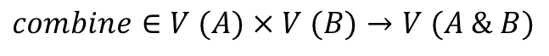
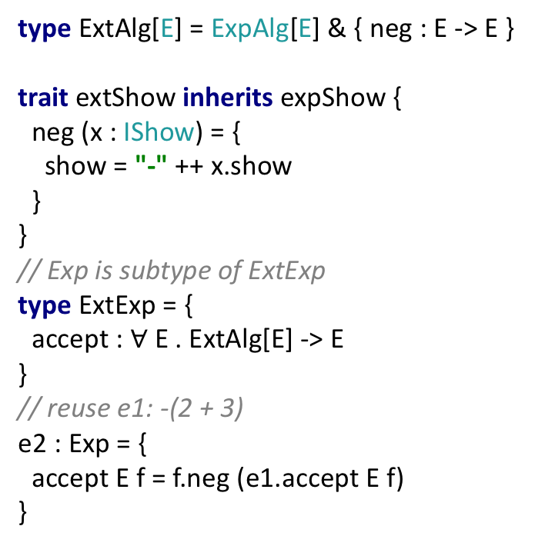
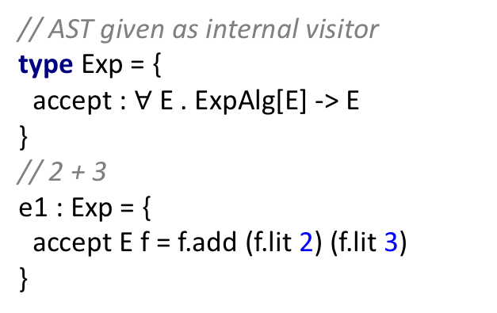
Modular Extensibility Challenge
// AST given as internal visitor type Exp = { accept : $∀$ E . ExpAlg[E] -> E }
// 2 + 3 e1 : Exp = { accept E f = f.add (f.lit 2) (f.lit 3) }
type ExtAlg[E] = ExpAlg[E] & { neg : E -> E } trait extShow inherits expShow { neg (x : IShow) = { show = "-" ++ x.show } }
// Exp is subtype of ExtExp type ExtExp = { accept : $∀$ E . ExtAlg[E] -> E }
// reuse e1: -(2 + 3) e2 : Exp = { accept E f = f.neg (e1.accept E f) }
type ExpAlg[E] = { lit : Int -> E, add : E -> E -> E } type IShow = { show : String } trait expShow { lit (x : Int) = { show = x.toString } add (x : IShow) (y : IShow) = { show = "(" ++ x.show ++ " + " ++ y.show ++ ")" } }
type IEval = { eval : Int } trait extEval { lit (x : Int) = { eval = x } add (x : IEval) (y : IEval) = { eval = x.eval + y.eval } neg (x : IEval) = { eval = -x.eval } }
$$combine∈V (A) × V (B)→V (A \& B)$$
expShow
extShow
// Object algebra combinator
combine A [B * A] (f : Trait[ExtAlg[A]])
(g : Trait[ExtAlg[B]]) = trait inherits f & g {} evalShow = combine IEval IShow extEval extShow o = e2.accept (IEval & IShow)
(new[ExtAlg[IEval & IShow]] evalShow) main = o.print ++ " = " ++ o.eval.toString // Output: "-(2 + 3) = -5"
extEval
Notes:
This combinator is analogous to the n-ary zip function in functional programming

Slide 17
Case Study
A case study on modularizing several orthogonal features of a small JavaScript-like language
Combination of first-class traits and improved object algebras
For each feature
An evaluator
A pretty printer
A type checker
Notes:
Staring from a simple arithmetic language, we gradually introduce new features and combine them with existing features

Slide 18
Languages Assembled

Slide 19
Summary
SEDEL offers typed first-class traits
Elaboration of high-level constructs to disjoint polymorphism
Improved design patterns such as object algebras
Also in the paper
Support of super, overrides and forwarding operator
Type soundness and coherence

Slide 20
Future Work
Flattening property
Add other practical programming features such as mutable state, recursive types
Relationship between disjoint polymorphism and row polymorphism

Slide 21
Thank you for listening!
Questions?

